Slide 1


Semantic Technologies for Enterprises
SAP Research BI Practice
07/11
Internal

Slide 2
Introduction
  “During the next three to five years, we [PwC] forecast a transformation of the enterprise data management function driven by explicit engagement with data semantics.”
  PwC Technology Forecast, PwC, Spring 2009
  “The next generation of IT will be structured around unified information management, Enterprise-level, semantically aware search capabilities, and intelligent collaboration environments - all delivered through dynamic, personalized interfaces that are aware of context”.
  Final Demand driven Mapping Report,research project value-it, 02/2010

Slide 3

You are here
http://freephotos.com/p/13124

Slide 4










Aletheia in a Nutshell
search
explore
visualize
annotate
Leveraging links
for information access
Graph with
meaningful links
Heterogeneous data sources
wiki
database
forum
GPS-data
manual
office
Notes:
Sources:enterprise environment; in project: product-related information; structured in databases + unstructured text; e.g. customer entry database related to mentioning of customer in document
Graph / ontology: ONE graph, ONE node per „thing“
UI: for search etc., take advantage of links/graph; do not require the user to learn a complicated language

Slide 5
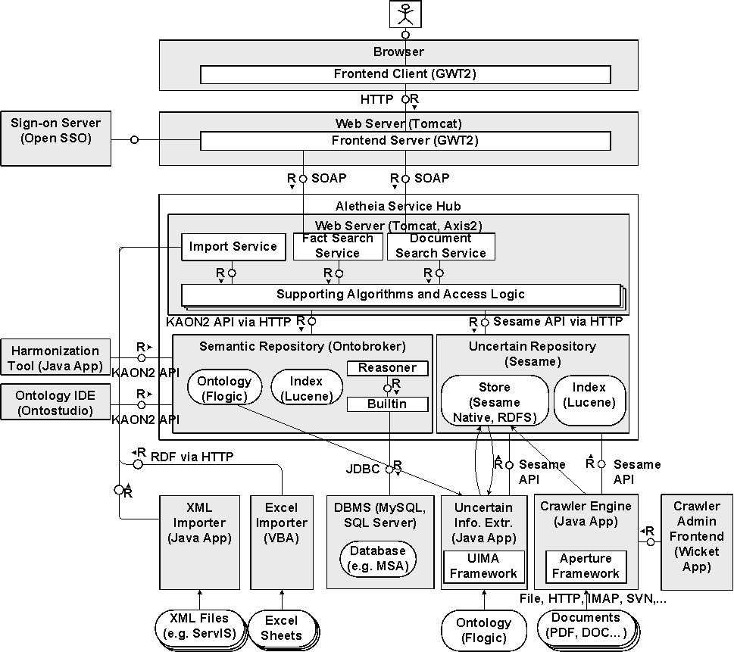
Prototype Architecture & Technologies

Slide 6




Semantic Technologies Used in Aletheia
Models
Languages and Technologies
    Relatively light-weight ontologies
      Synonyms, homonyms, relationships …
      Classes: e.g. product, customer, engineer …
    Rules
      for data source mapping
      for making relationships (even between entities from different source) explicit
      some domain knowledge
    FLogic
      Ontology / Schema (~RDFS-equivalent)
      Queries
      Rules
      Ontobroker / Ontostudio
    RDF/RDFS
      Sesame
Algorithms
UI
    NLP, IE, computational linguistics
      for semantic indexing of unstructured text
    Information lifting (e.g. from XML to RDF)
    Semi-automatic linking of imported instances
    Rules (see above)
    Interpretation of user entries as semantic queries
    Faceted navigation
      Including navigation along relations
    Interactive, graph-based visualization
    (syntactic keyword search)
Notes:
Information lifting refers to the demo of „Dokumentenintegration“, where instances from an Excel-Sheet are imported and linked with Johannes‘ tool to the existing instances.

Slide 7
(This is) Food for Thought

Slide 8
What are Semantic Technologies?
In software, semantic technology encodes meanings separately from data and content files, and separately from application code.
Wikipedia
Semantic Technologies are designed to extend the capabilities of information on the Web and enterprise systems to be networked in meaningful ways. The adoption of World Wide Web Consortium (W3C) standards like XML, RDF (Resource Description Framework) and OWL (Web Ontology Language) serve as foundation technologies to advancing the adoption of semantic technologies.
Oracle
Semantic Web is a major international research effort with the goal to make web content available for intelligent knowledge processing. It draws on standard and novel techniques from various disciplines within Computer Science, including Knowledge Management, Artificial Intelligence, Databases, Internet Technology, Software Agents and Electronic Commerce. The methods and tools developed and integrated for this purpose - often called Semantic Technologies - are generic and have a very large application potential outside the domain of the Semantic Web.
AIFB

Slide 9
What are Semantic Technologies
Business Case?
Enablers for Semantic Technologies
information and meaning extraction,
autorecognition of topics and concepts
categorization
Core Semantic Technologies
Ontology languages, like RDFS, OWL, or FLogic
Ontology Editors, like Protégé or OntoStudio
Triple stores and semantic repositories, like OWLIM
Semantic Middleware, like OntoBroker
Semantic Frameworks, like Sesame
Reasoners, like pellet
Notes:
It should be noted that we do not restrict ourselves to Semantic Web technologies, but include for example FLogic as language and the corresponding applications from Ontoprise like OntoStudio and OntoBroker as well.

Slide 10
Semantic Web vs. Semantic Enterprise
(simplified view)
differences are overstressed
and not that strict
Web
Enterprise
    Existing (legacy) data
      Unstructured data (like txt, doc, pdf)
      Semistructured data (like html)
    Domain
      Open world
      No unique name assumption
      Unrestricted domain
    User
      No context, no roles, no access restrictions
    Governance
      Not existing
    Data
      Unstructured data (like txt, doc, pdf, xls)
      Semistructured data (like html)
      Structured data
        e.g.RDMS, from ERP systems)
        e.g. xml + schema)
    Domain
    Closed world
    Unique name assumption
    Restricted domain
    Sometimes existing business vocabulary
    User
    Context, roles, access restrictions
    Governance
      For vocabularies, content, access, development
Notes:
Comments:
In the Web, we have –of course- meanwhile attempts for structuring the information, e.g. by using RDFa, ontologies (FOAF etc). Let’s think more of the web a few years ago.
Closed world vs open world: This is certainly a matter of debate. … E.G. Michael K. Bergman (CEO and co-founder of Structured Dynamics LLC) stresses in “Seven Pillars of the Open Semantic Enterprise”, an open world mindset is fundamental.

Slide 11

Costs & Benefits
Photo: http://www.morguefile.com/archive/display/196927
Notes:
personally most interesting: what are the advantages of doing it this way + discuss about arguments against

Slide 12
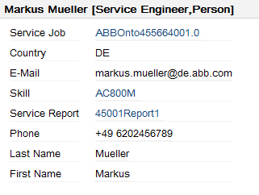
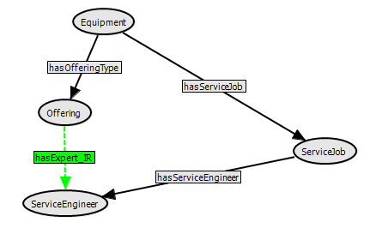

Benefit #1: Data Integration and Federation
Product Specification Database
Service Reports
Rule
wiki
database
forum
GPS-data
manual
office
Notes:
1: Federation
Come back to Aletheia Example
Diff. Databases -> more infor ressources and more file formats -> unstructrured (>80%), semi-structured, structured -> internal and external data (e.g. odata)
2: Derivation of new facts from old facts
explain example
the only added value that requires more than basic RDFS-reasoning
in the project, more of a nice-to-have thing; could be implemented differently (busines rule engines), but ellegant to do it in the model
3: Answering queries that require the combination of multiple data sources
Explain example
major advantage for ABB
but: similar in a data warehouse / ETL

Slide 13
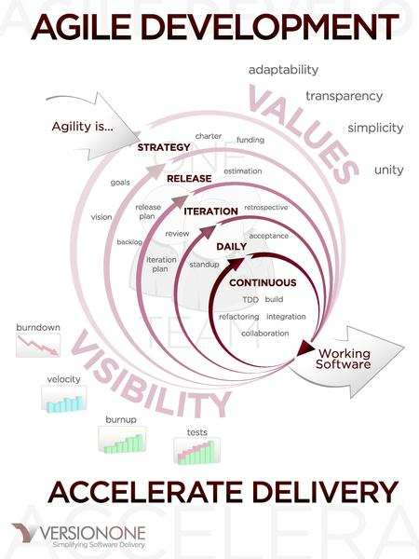
Benefit #2: Agile Schema Development
Understanding
the Problem
Planning
Designing
Implementing
Testing,
Evaluating and Maintaining
created by Dbenson and VersionOne, Inc. ,licensed under the Creative Commons Attribution CC-BY-SA license.
Notes:
Schemata for data and information are usually not very stable
too high fraction of the enterprise data models and business logic is still hard coded in the applications. For this reason, it is error prone and costly to employ changes in the model or business logic.
With ST:
due to the high expressiveness of semantic models (i.e., ontologies), it is possible to capture a relatively high amount of the enterprise information model and business logics in the semantical model
not necessary to develop a schema first: It is instead possible to store data in a semantical persistency layer (e.g., a triple store) and add later the corresponding schema information.
The separation of application and business logic lowers the TCO
In Aletheia, following a waterfall model in the schema development was not feasible. Instead, the schema has evolved over many iterations (calls betwen ontology experts and domain experts), in which the schema was refined, change, and tested.

Slide 14
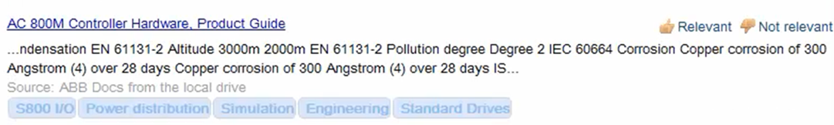
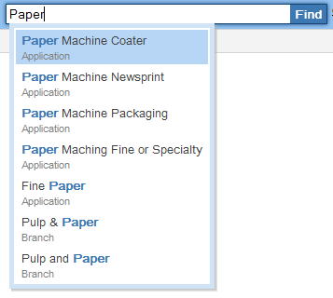
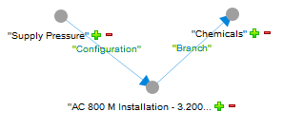
Benefit #3: Semantic Search Capabilities
Notes:
Lower left: Improved understanding between human and machine by disambiguation of user input
user: faster input, more precise input, disambiuate homonyms, find also via synonyms
how much is this worth to the user? (e.g. in domains where there are a lot of acronyms)
Lower right: Search mechanisms that leverage relationships between the objects of interest
intuitive, what the users means
could be done over relational database (as with Enterprise Search), but just for specific cases (not generically for all relationships)
Upper: Documents search based on detected concepts
Explain example (AC 800M is a special Standard Drive)
could also be done with other structured background data (e.g. a databsase), but the metadata from the ontology (e.g. hierarchies) are very useful

Slide 15

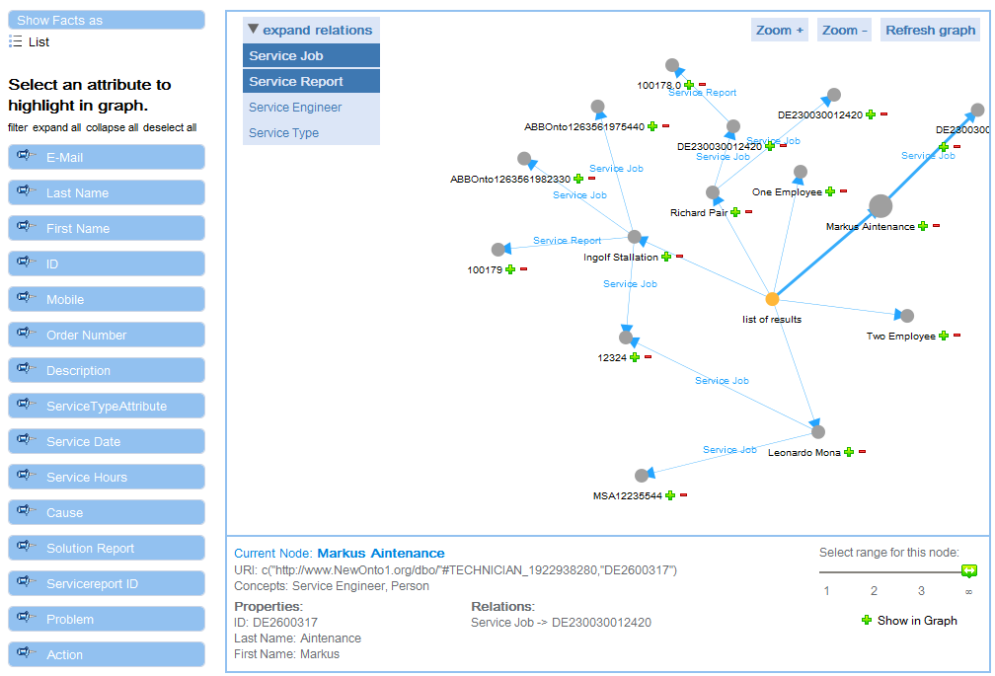
Benefit #3: Semantic Search Capabilities
Notes:
Lower left: Improved understanding between human and machine by disambiguation of user input
user: faster input, more precise input, disambiuate homonyms, find also via synonyms
how much is this worth to the user? (e.g. in domains where there are a lot of acronyms)
Lower right: Search mechanisms that leverage relationships between the objects of interest
intuitive, what the users means
could be done over relational database (as with Enterprise Search), but just for specific cases (not generically for all relationships)
Upper: Documents search based on detected concepts
Explain example (AC 800M is a special Standard Drive)
could also be done with other structured background data (e.g. a databsase), but the metadata from the ontology (e.g. hierarchies) are very useful

Slide 16









Benefit #4: Collaborative / Social Computing

Slide 17











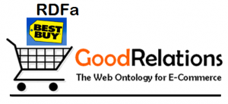















Cost #1: Technical Challenges
F-logic
Notes:
“Complexity of an additional technology stack”
Technologies not so known to most developers
but: There are also other products/componetns with graph stores (AIS, FindGrid)#

Slide 18
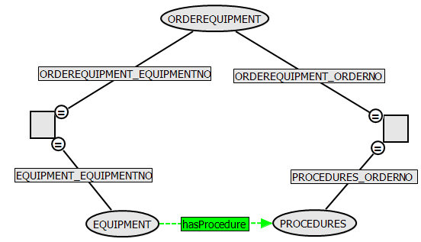
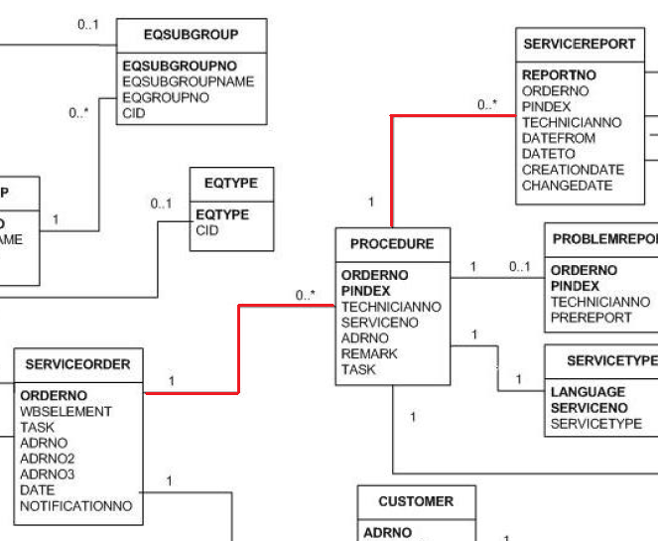
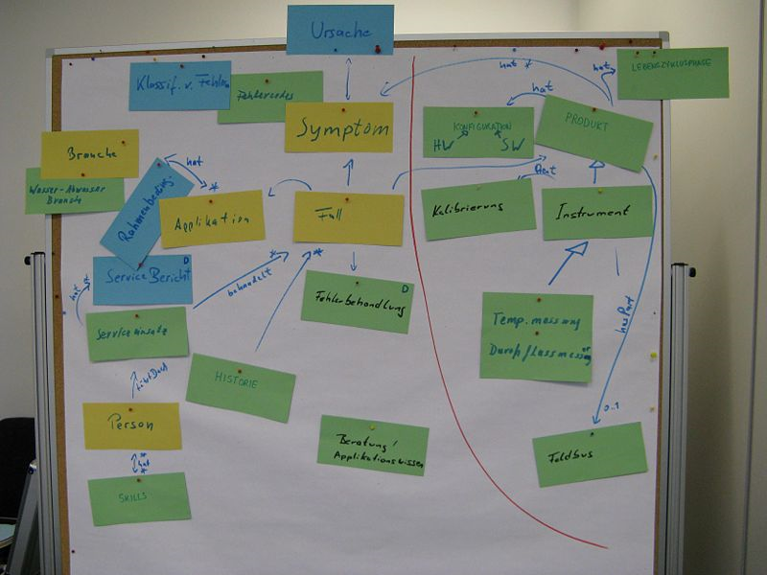

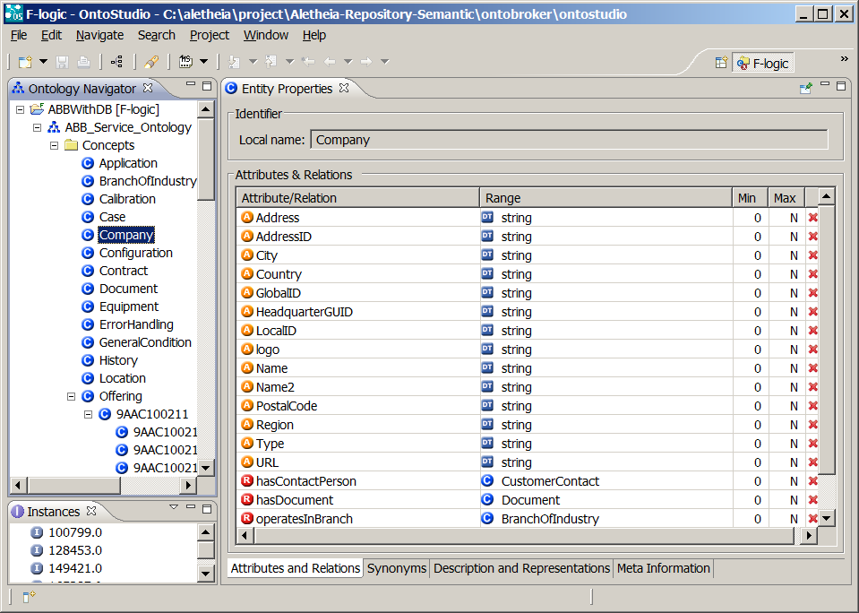
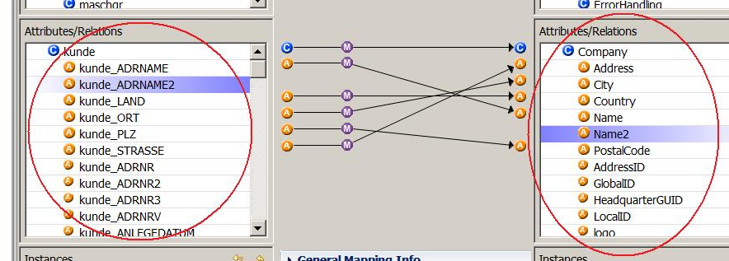
Cost #2: Modelling Challenges
Notes:
Manual operation effort”
will never be fully automated
but: it is an investment, can be reused
but: the ontologies are often already there in other formats, not called ontologies, in many different systems (Search Models, MDRS metamodels, product taxonomies)

Slide 19
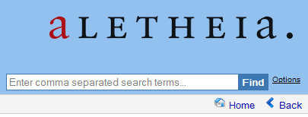


Cost #3: Measuring Challenges
Searching …
Effectiveness
Efficiency
?
User Satisfaction
Notes:
“Performance and scalability”
more flexible -> not as quick as databases
in project: jetzt tens of thousands of database entries, limits of Ontobroker reasoning engine (work in progress)
but: heavy-weight reasoning often not necessary; we could use very scalable triple stores like Virtuoso
but: in combination with in-memory, we believe the approach is Technical dimensions like performance and scalability
* User-centric dimensions like the effectiveness of semantic models for users (e.g., compared to relational models)
* Cost-centric dimensions like the TCO for employing ST
fit for enterprise-level data sets

Slide 20



Cost #4: Educational Challenges

Slide 21
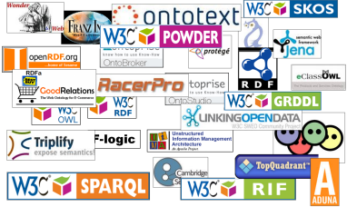
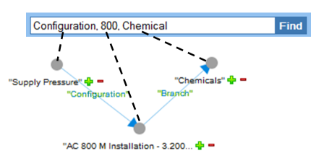
Cost #4: Educational Challenges

Slide 22
Buy-In for ICCS
Photo: http://www.morguefile.com/archive/display/196927
Notes:
personally most interesting: what are the advantages of doing it this way + discuss about arguments against

Slide 23
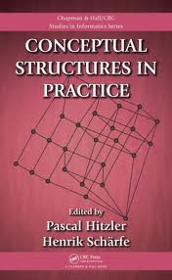


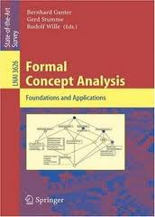

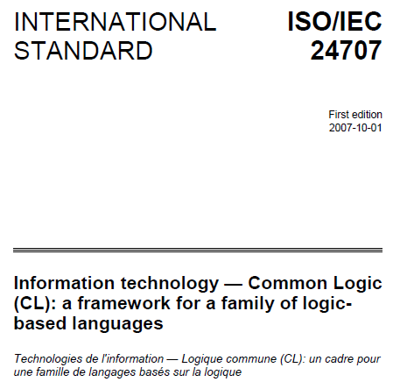

Buy-In for ICCS?
from expertise …
… to action
Notes:
Comments:
In the Web, we have –of course- meanwhile attempts for structuring the information, e.g. by using RDFa, ontologies (FOAF etc). Let’s think more of the web a few years ago.
Closed world vs open world: This is certainly a matter of debate. … E.G. Michael K. Bergman (CEO and co-founder of Structured Dynamics LLC) stresses in “Seven Pillars of the Open Semantic Enterprise”, an open world mindset is fundamental.

Slide 24

Questions?

Slide 25
Thank You!
Contact information:
Frithjof Dau
Senior Researcher
SAP Research Dresden, Chemnitzer Strasse 48, D-01187 Dresden
0049 351 4811 6152

Slide 27
Cost #4: Educational Challenges
To Do
Notes:
Developpers and users

